Slide 1
CAPACITY ANALYSIS PROJECT
BY
Badam Alivelu Laxmi Mani Harika
Student no.: 20000628-T083

Slide 2
Table of contents
Introduction
Scenario
Aim
Materials used
Analysis
Results
Appendix
References

Slide 3
Introduction
Until now we have seen many cases where the customers eventually get served. But in our daily life, we come across some impatient customers who initially join the queue, but leave the queue without being served if it is taking a longer time (some finite value). In queueing theory, there is a term reneging which means joining the queue but leaving without taking the service. This type of customers is a problem in business field as it can lead to a huge loss in the revenue of the business.
Here, we are going to see one such case of M/M/1 system where all the customers are of this type.

Slide 4
Scenario
At a metro station, there is only one metro train ticket counter. Assume, arrivals to this counter are following a poisson distribution with a rate of 25 customers per hour and service times are following an exponential distribution with rate of 40 customers per hour.
This ticket counter also has a fixed queue length of 6 customers and works for 10 hours a day without any break.
Customers will wait in the queue for at most a threshold value (T_{v}), which follows a uniform distribution between 8 minutes to 10 minutes. If they did not receive the service within this time, they simply leave the queue without getting service.
The manager has noticed that people are leaving the system after joining the queue and realizes that this is directly affecting the revenue of their business and wants to know how many people are leaving this way and what is the fraction of people who are leaving this way, in one day.
After finding that, he wants to find out what is the minimum service rate he has to maintain if the fraction of customers who are leaving the queue without taking service should not exceed 0.1 if the maximum service rate, he can provide is 0.84.

Slide 5
Aim
To observe the one-day activity at the metro ticket counter and finding out:
1) The number of customers who are leaving the queue without taking the service. And also finding out what fraction of the customers are leaving the queue this way in one day, using matlab.
2) Minimum service rate to be maintained so that the fraction of customers who leave the queue without getting service should not exceed 0.1 using matlab.

Slide 6
Materials used
Matlab tools, functions and documentation
Problem set-8 (Qps8.m)

Slide 7
Analysis
Information given:
The system is a M/M/1/7 and the discipline followed here is FCFS (First Come First Serve).
Arrival rate = 25/60 = 0.4167
Departure rate = 40/60 = 0.6667
End time (in minutes) = 600
Maximum queue length = 6

Slide 8
Method:
At regular time intervals (which is a uniformly distributed random value between 1 and 2), I am calculating the waiting time of all the customers in the queue. If any of the customers waiting time is greater than the threshold value (which is a uniformly distributed random value between 8 to 10 minutes), then the departed time of that customer is updated.
For calculating the minimum service time so that the number of customers who left the system without taking service to be less than 5, I have plotted a graph for all the mu values (between 0.6667 and 0.84) and number of customers who left. Using these values, I have calculated the minimum mu value.

Slide 9
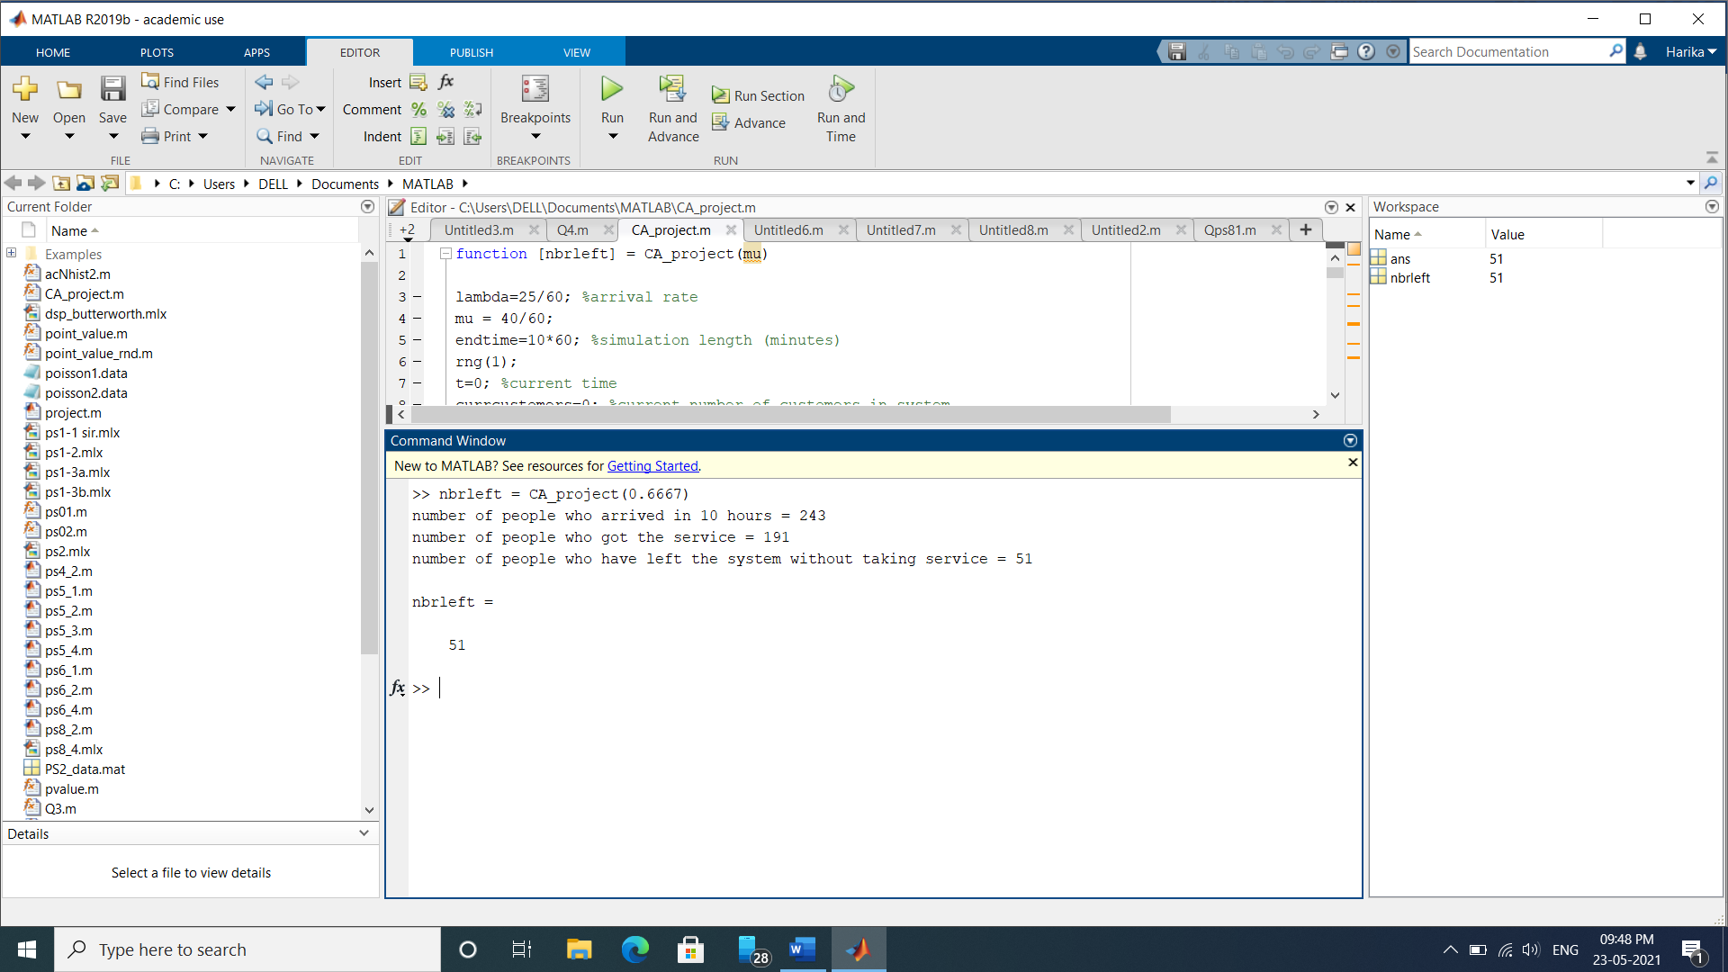
Results
Fraction of customers who left the queue without service = 0.2099

Slide 10
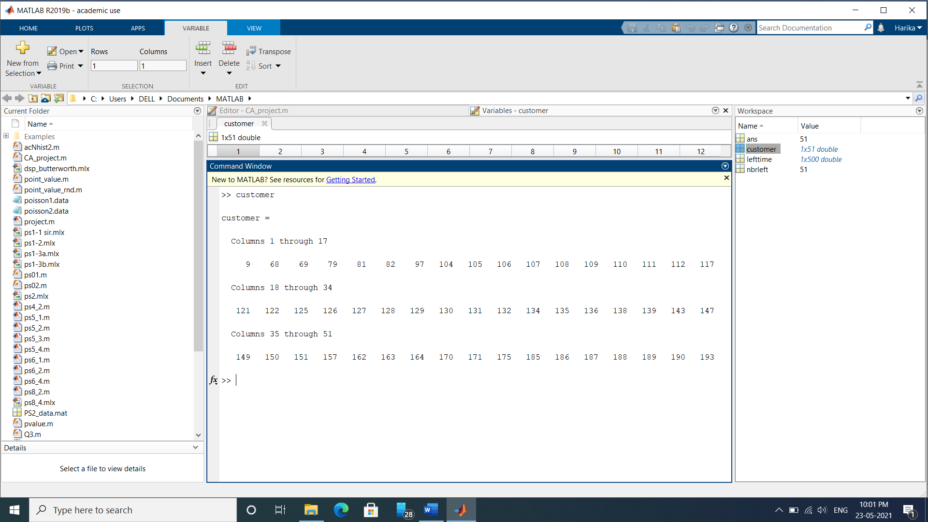
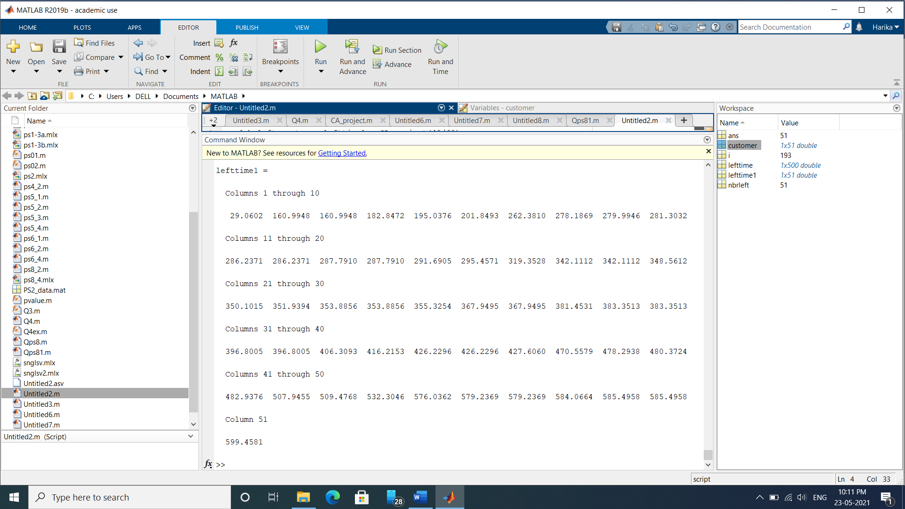
customers who left without service:
time at which the customers left without taking the service:

Slide 11
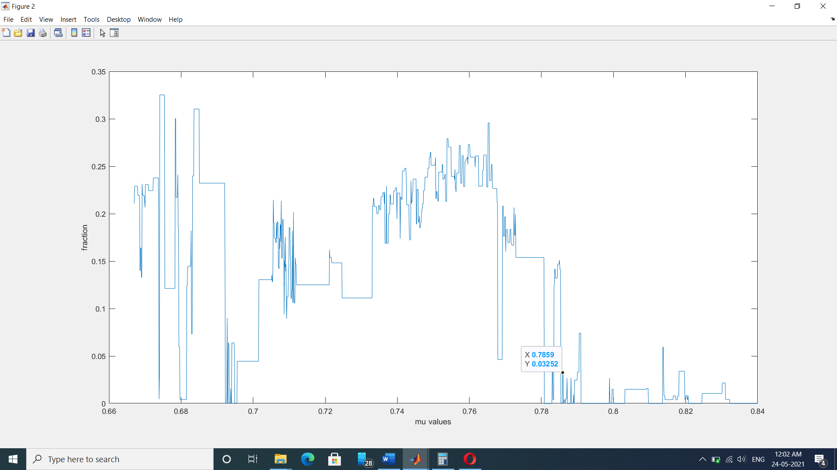
Minimum mu value to be maintained so that the fraction of customers who leave the queue without getting served should not exceed 0.1 is approximately 0.7859.

Slide 12
References
Lecture PPTs and problem sets provided by Siamak Khatibi
https://www.researchgate.net/publication/307742156_MM1N_Queuing_System_with_Retention_of_Reneged_Customers

Slide 13
Thankyou

